Slide 1
JAVA BASIC
Course 100% Practical, real no fake.

Slide 2
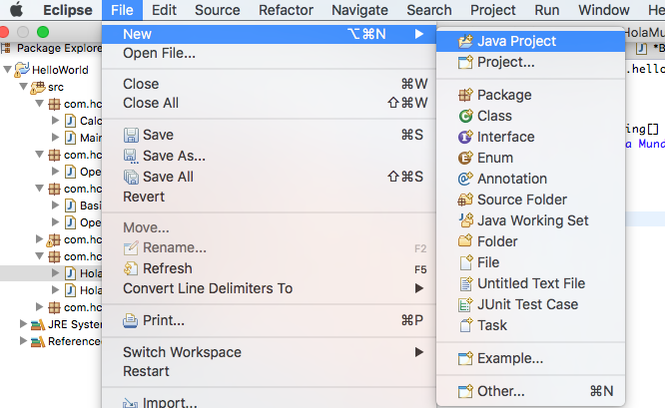
Create a New Java Project
Key Concepts:
Workspace

Slide 3
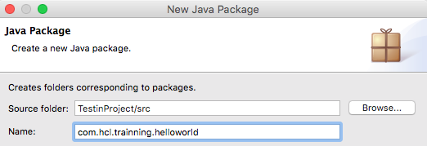
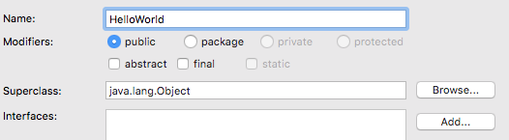
Create a Package and Classes
Key Concepts:
Package
Class
Attributes
Methods

Slide 4
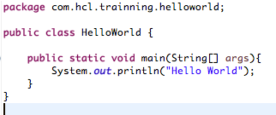
Method
Key Concepts:
Access Modifiers
public
private
protected
default
Other class modifiers
static
Methods
Return values
Objects
Primitives
void

Slide 5
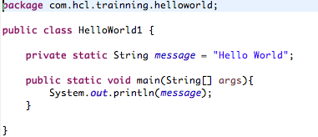
Refactor I
Key Concepts:
Refactor
Attributes (yep, again)
Access modifiers for attibutes (are the same XD)

Slide 6
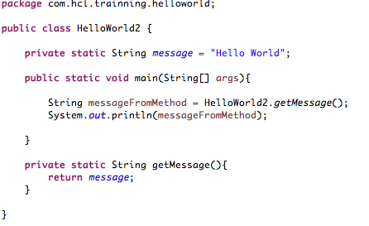
Refactor II
Key Concepts:
Methods (no new topics for today)
Return value
Difference between static and non-static methods.

Slide 7
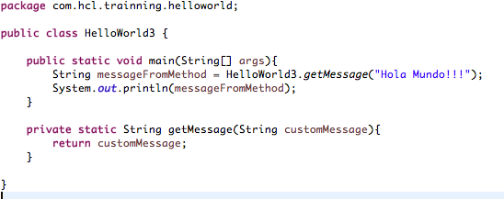
Refactor III
Key Concepts:
Return types

Slide 8
¿Preguntas?

